Slide 1

Logistic Regression
N Omkar

Slide 2
Agenda
Problem Statement
Linear Regression vs Logistic Regression
Sigmoid Function
Log Odds Ratio
How to find parameters
Classification Metrics

Slide 3


Example 1: Tumour Size Vs Tumour Type
?
Benign
Tumour
Tumour
Tumour
Malignant
Benign
Benign
Benign
Malignant

Slide 4
Example: Tumour Size Vs Tumour Type
The Data Set
Tumour Size
Tumour Type
0 = Benign
1 = Malignant
Absence of Malignance
0.5
2.5
0.75
5
15
:
:
0
0
1
0
1
:
:
Presence of Malignance

Slide 5
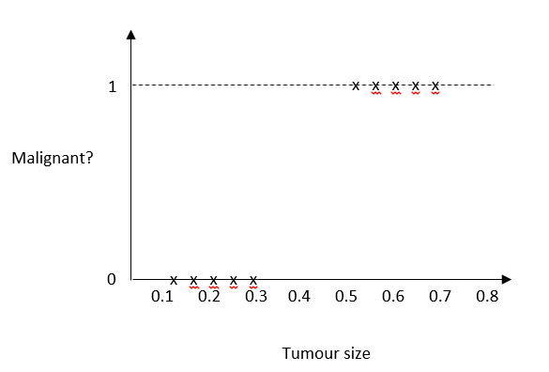
Can we use Linear Regression to Model the Problem?
Linear regression line

Slide 6
Limitations???
What do we mean by tumour type = 0.6?!!
What do we mean by tumour type = 1.2?!!
1.2
0.6

Slide 7
Huge RSS!!

Slide 8
Probabilistic Outcome
Sigmoid Function
1
Tumour Size
P(Tumour = 1| Tumour Size)
0.0 – 5.0
5.0 – 10.0
10.0 – 15.0
15.0 – 20.0
25.0 – 30.0
:
:
0.05
0.25
0.27
0.38
0.43
:
:
P(Tumour = 1| Tumour Size)
0
Tumour Size

Slide 9
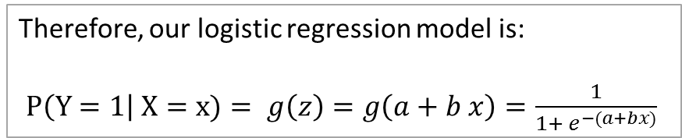
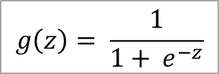
Sigmoid Function
Sigmoid Function
$$g\left(z\right)= \frac{1}{1+ e^{−z}}$$
1
In this Problem: z = a + b*x
P(Tumour Type=1| Tumour Size)
Therefore, our logistic regression model is:
$P\left(Y=1\right| X=x)= g\left(z\right)=g\left(a+b x\right)=\frac{1}{1+ e^{−(a+bx)}}$
0
Tumour Size

Slide 10






GLM
Linear Model
$$Range$$
$$−∞$$
Link Function (e.g. Sigmoid)
$$+∞$$
GLM
$$New Range$$
$$0$$
$$1$$
When you take a linear model $y=a+ b_{1}x_{1}+b_{2}x_{2}+ …+b_{d}x_{d}$that ranges from $−∞$ to $+∞$ and squeeze it into the range $(0, 1)$ using a link function then what you are building is called Generalized Linear Model.

Slide 11
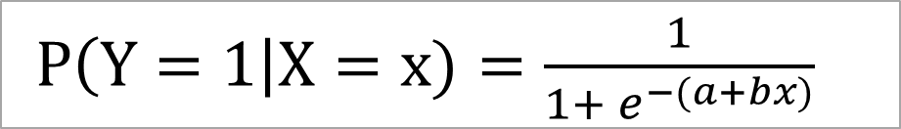
Logistic Regression Model
$P\left(Y=1\right|X=x)=\frac{1}{1+ e^{−(a+bx)}}$
Conditional Probability of Y given that X takes the value x,
e.g. Probability that a tumour type (Y) is malignant (Y=1) given that its size (X) is 7 mm (x)
Non-Linear Function!

Slide 12
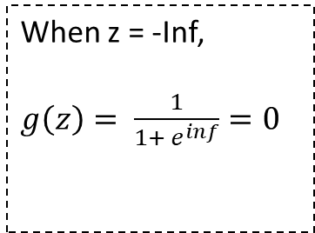

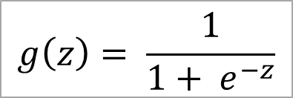

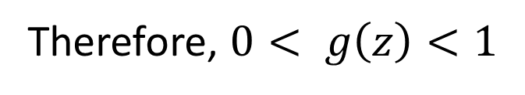
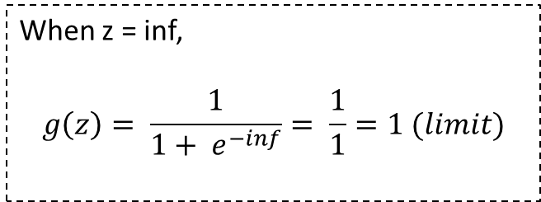
Range of Sigmoid Function
$$g\left(z\right)= \frac{1}{1+ e^{−z}}$$
When z = -Inf,
$g\left(z\right)= \frac{1}{1+ e^{inf}}=0$
When z = inf,
$$g\left(z\right)= \frac{1}{1+ e^{−inf}}= \frac{1}{1}=1 (limit)$$
Therefore, $0< g\left(z\right)<1$
Note:
$$\exp\left(−Inf\right)=0$$
$$\exp\left(Inf\right)=Inf$$

Slide 13
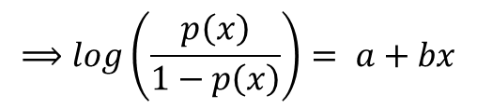
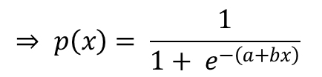
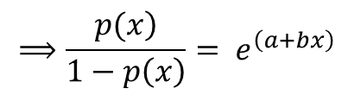
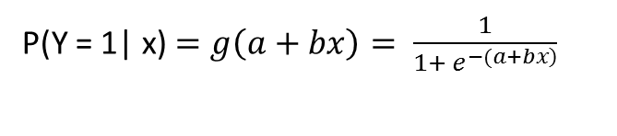
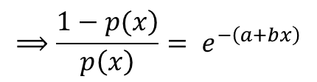
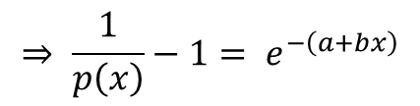
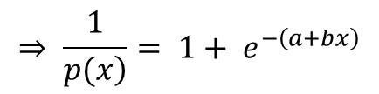
Linear Transformation
P(Y = 1| x) $=g\left(a+bx\right)= \frac{1}{1+ e^{\left.−(a+bx\right)}}$
$$⟹\frac{\left.1−p(x\right)}{p\left(x\right)}= e^{−\left(a+bx\right)}$$
Let us write P(Y=1|x) as p(x), for simplicity
$$⟹\frac{\left.p(x\right)}{1−p\left(x\right)}= e^{\left(a+bx\right)}$$
$$⇒ p\left(x\right)= \frac{1}{1+ e^{−\left(a+bx\right)}}$$
$$⟹log\left(\frac{p\left(x\right)}{1−p\left(x\right)}\right)= a+bx$$
$$⇒ \frac{1}{\left.p(x\right)}= 1+ e^{−\left(a+bx\right)}$$
, Taking Reciprocal
$$⇒ \frac{1}{p\left(x\right)}−1= e^{−\left(a+bx\right)}$$
Linear model

Slide 14
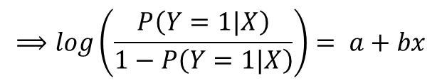
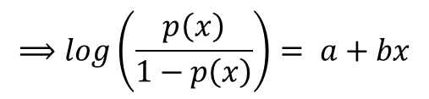
Logistic Regression Model in Linear Form
$$⟹log\left(\frac{p\left(x\right)}{1−p\left(x\right)}\right)= a+bx$$
$$⟹log\left(\frac{P\left(Y=1|X\right)}{1−P\left(Y=1|X\right)}\right)= a+bx$$
Odds of Y=1
Interpreting the coefficient b:
With one unit increase in the value of x the log of odds of Y will increase by an amount equal to b, provided all the other factors remains constant.

Slide 15
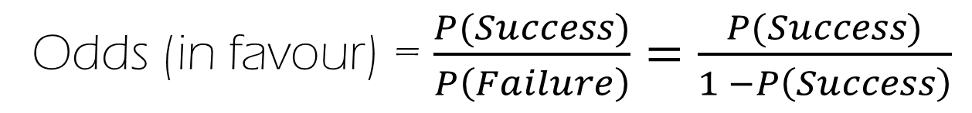
Odds Vs Probability
Odds (in favour) = $\frac{P(Success)}{P\left(Failure\right)}=\frac{P(Success)}{1 −P\left(Success\right)}$
Note: Probability ranges between 0 and 1, while odds ranges between 0 and infinity

Slide 16
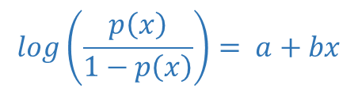
How this Entire Process Work?
We are interested
in the Probability outcome.
x = Tumour Size
Y = Tumour Type (0/1)
$$log\left(\frac{p\left(x\right)}{1−p\left(x\right)}\right)= a+bx$$
Convert Odds to Probability
Fit Logistic Regression model
Predict Odds (Y = 1|x)
Predict P(Y=1|x)
Training Data
Predict Class
0 OR 1
Our Final Interest is in Class!

Slide 17
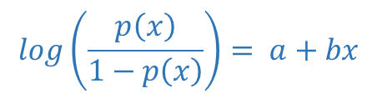
How this Entire Process Work?
PROBLEM 1
PROBLEM 2
Predict Probability from odds
Fit Logistic Regression model
Predict Odds (Y = 1|x)
Predict P(Y=1|x)
Training Data
$$log\left(\frac{p\left(x\right)}{1−p\left(x\right)}\right)= a+bx$$
Predict Class
0 OR 1
Estimate a and b
PROBLEM 3
Predict class from Probability

Slide 18

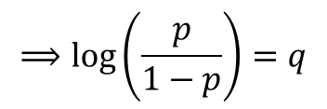




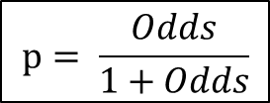
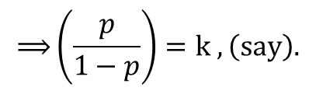
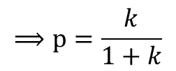
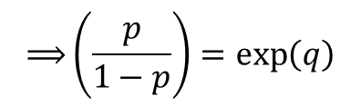

Problem 2 - Deriving Probability from Odds
$$Let, log\left(odds\right)=q$$
$$⟹p=k−kp$$
$$Therefore,$$
$$⟹p+kp=k$$
$$p= \frac{Odds}{1+Odds}$$
$$⟹log\left(\frac{p}{1−p}\right)=q$$
$$⟹p\left(1+k\right)=k$$
$$⟹\left(\frac{p}{1−p}\right)=\exp\left(q\right)$$
$$⟹p=\frac{k}{1+k}$$
$$⟹\left(\frac{p}{1−p}\right)=k , \left(say\right).$$
$$⟹p=k\left(1−p\right)$$
What was k? Odds right???

Slide 19

Why Probability?
Interpretation: Probability that the tumour is malignant given that its size is 9.75 mm is 0.81 (i.e. there is 81% chance of that tumour to be malignant given this size!). The tumour is probably malignant.
Tumour
Say, Classified as 1
$$P\left(Tumour=Malignant | size=9.75\right)=0.81$$
$81$% Chance!
Say, Classified as 1
But how confident are we???
$$P\left(Tumour=Malignant | size=2.50\right)=0.50$$
Tumour
Say, Classified as 1
$$P\left(Tumour=Malignant | size=5.77\right)=0.65$$

Slide 20
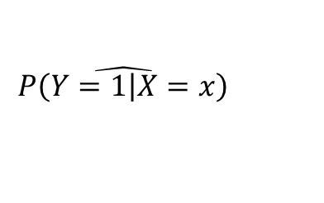
Problem 3 – Predicting Class from Probability
$$\hat{\left.P\left(Y=1\right|X=x\right)}$$
But we would like to understand…
Tumour Size
Tumour Type
0.5
2.5
0.75
5
15
:
:
0
0
1
0
1
:
:
0.05
0.12
0.03
0.19
0.73
:
:
Malignant or Benign?
Malignant or Benign?
Predicted Probability values
Malignant or Benign?

Slide 21
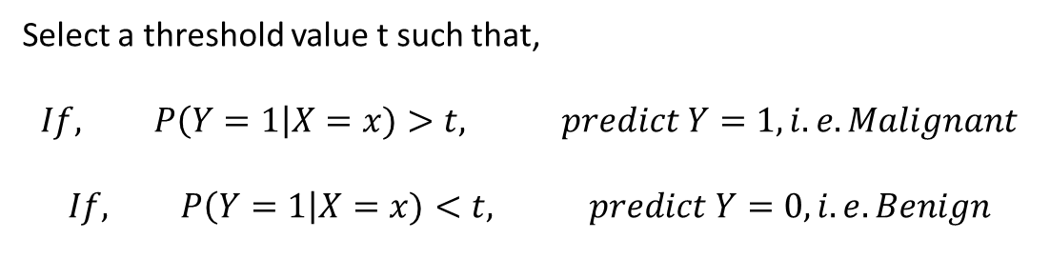
Select a Threshold
Select a threshold value t such that,
$$If, P\left(Y=1\right|X=x)>t, predict Y=1, i.e. Malignant$$
$$If, P\left(Y=1\right|X=x)<t, predict Y=0, i.e. Benign$$
But what value of t should we select???

Slide 22

Threshold Selection
Benign
Malignant
Some malignant tumours got mis-classified as benign!
What happens if t is large?
$$P\left(Y=1\right|X=x)$$
0
1
Disadvantage
0.70
More misclassification here!
That is we make more error in classifying malignant.
In Reality,
0
1
0.70

Slide 23
Threshold Selection
Advantage
What happens if t is large?
Focus in detecting worst cases where immediate intervention is required (with high priority).
$$P\left(Y=1\right|X=x)$$
0
1
0.70
In Reality,
0
1
0.70

Slide 24
Threshold Selection
Disadvantage
Some benign tumours got mis-classified as malignant!
What happens if t is too small?
$$P\left(Y=1\right|X=x)$$
0
1
0.30
More misclassification here!
That is we make more error in classifying malignant.
In Reality,
0
1
0.30

Slide 25
Threshold Selection
Advantage
Detect all patients who might be having malignant tumours and start treating them at a very early stage!
What happens if t is too small?
$$P\left(Y=1\right|X=x)$$
0
1
0.30
In Reality,
0
1
0.30

Slide 26
Threshold Selection
Note:
Some decision-makers often have a preference for one type of error over the other, which should influence the threshold value they pick.
If there's no preference between the errors, the right threshold to select is t = 0.5, since it just predicts the most likely outcome.

Slide 27
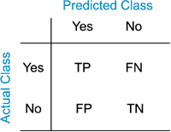
Confusion Matrix
No. of actual positive cases that are correctly predicted as positive
No. of actual positive cases that are incorrectly predicted as negative
No. of actual negative cases that are incorrectly predicted as positive
No. of actual negative cases that are correctly predicted as negative

Slide 28
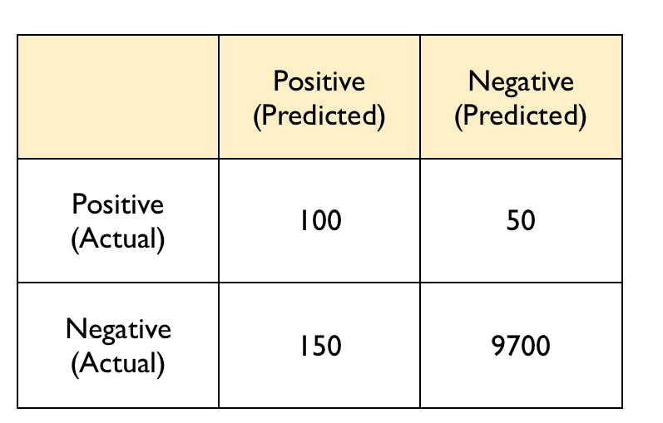
Confusion Matrix: Example
Total number of observations = (100 + 50 + 150 + 9700) = 10000
Total number of positive cases = (100 + 50) = 150
Total number of negative cases = (150 + 9700) = 9850
TP = 100, i.e. 100 out of 150 positive cases are correctly predicted as positive.
FN = 50, i.e. 50 out of 150 positive cases are incorrectly predicted as negative.
FP = 150, i.e. 150 out of 9850 negative cases are incorrectly predicted as positive.
TN = 9700, i.e. 9700 out of 9850 negative cases are correctly predicted as negative.

Slide 29
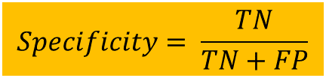
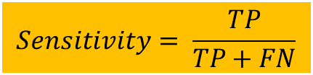
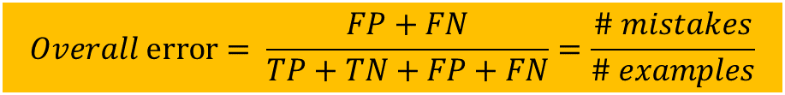
Measures of Error
Sensitivity measures the proportion of actual positive cases that we classify correctly. This is often called the true positive rate
$$Sensitivity= \frac{TP}{TP+FN}$$
Specificity measures the percentage of actual negative cases that we classify correctly. This is often called the true negative rate.
$$Specificity= \frac{TN}{TN+FP}$$
$$Overall error= \frac{FP+FN}{TP+TN+FP+FN}=\frac{\# mistakes}{\# examples}$$
Overall accuracy measures the proportion of cases that are predicted incorrectly.

Slide 30
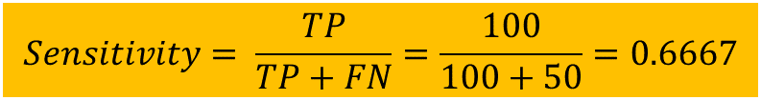

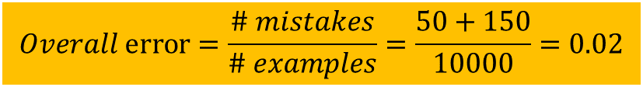
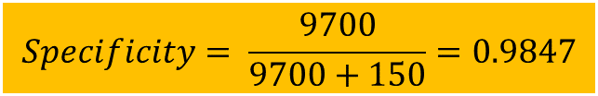
Calculation of Errors
$$Sensitivity= \frac{TP}{TP+FN}=\frac{100}{100+50}=0.6667$$
66.67% of the positive cases were predicted correctly by the model
$$Specificity= \frac{9700}{9700+150}=0.9847$$
98.47% of the negative cases were predicted correctly by the model
$$Overall error=\frac{\# mistakes}{\# examples}=\frac{50+150}{10000}=0.02$$
$$Overall accuracy=1 − 0.02=0.98$$
0.02% of examples were incorrectly predicted by the model

Slide 31
Again! How to select threshold?
Some decision-makers often have a preference for one type of error over the other, which should influence the threshold value they pick.
Therefore, selection of threshold actually depends on the business problem, how much of the error can be compromised and other constraints.

Slide 32
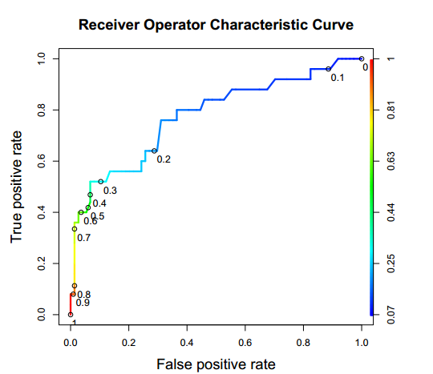
ROC (Receiver Operating Characteristic) Curve

